Slide 1
05/15 Meeting

Slide 2
Contents
Data Overview
Modelss
This week’s plan

Slide 3

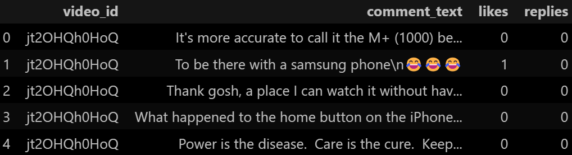
Data Overview
Source: Youtube(video title + comments)
Size: US - 2,364 videos; 434,075 unique comments
GB - 1,736 videos; 372,844 unique comments
US_videos:
US_comments:

Slide 4
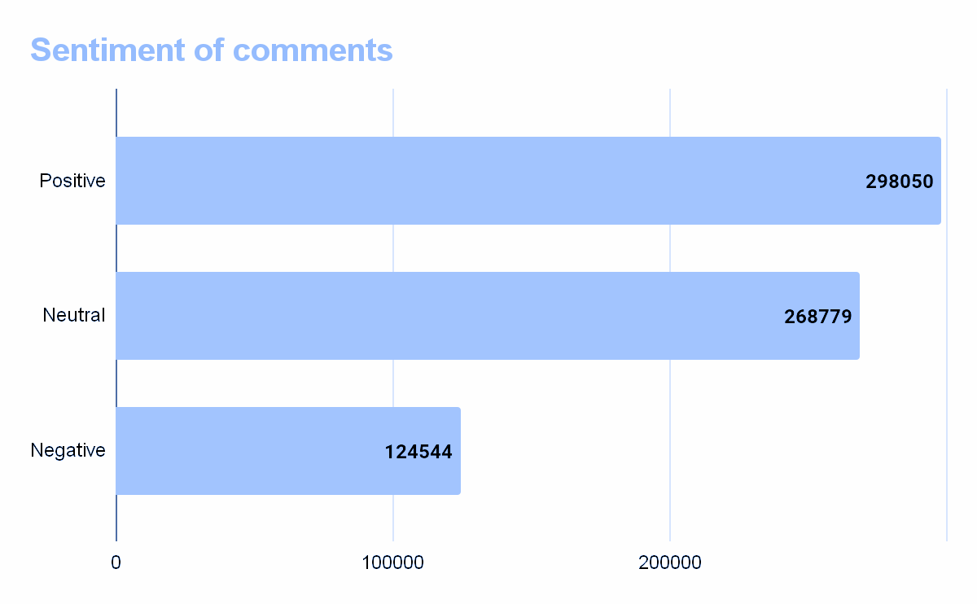

Slide 5
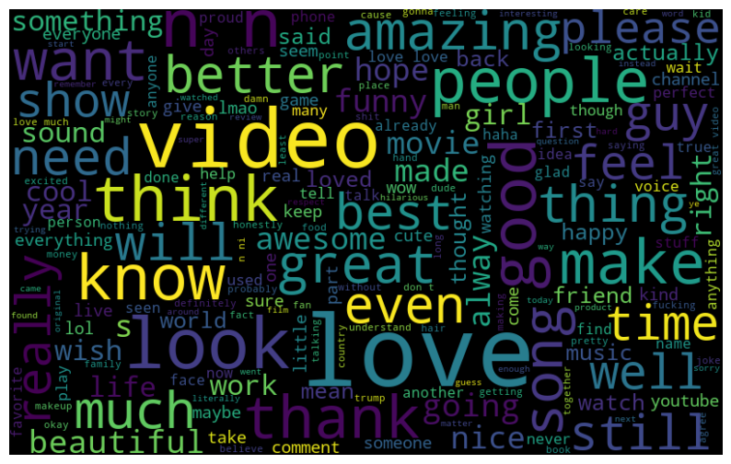
Word Cloud(Positive)

Slide 6
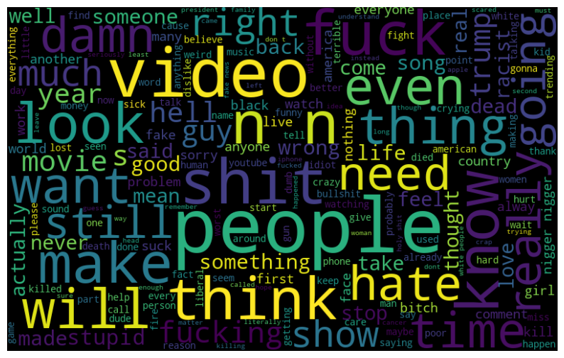
Word Cloud(Negative)

Slide 7
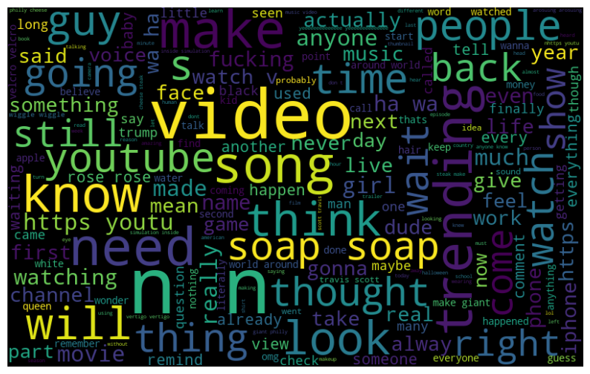
Word Cloud(Neutral)

Slide 8
So we have …
Sufficient amount of text data
Sufficient sentiments in comment text(and inappropriate words)
Rich use of words(324655 for US dataset)

Slide 9


Functions to be implemented
Comment Funnel Function
Input Filtering System

Slide 10


Model Choices

Slide 11
Comment Funnel Function
Model
Output
New Comment
Summarized Comment
Status?
Dictionary

Slide 12
For discussion
Input
API
Functional Input
*Meeting with Camosun team
Model
Structure
Content
Output

Slide 13
This Week’s Plan
Develop Comment Funnel Model
Define criteria for filtering comments
Determine the standards for module docking
*Model development

Slide 14
Discussion
Q & A

Slide 15

Thanks!

